Slide 1
Contoso Insurance: Automated Call Center
Richin Jain

Slide 2
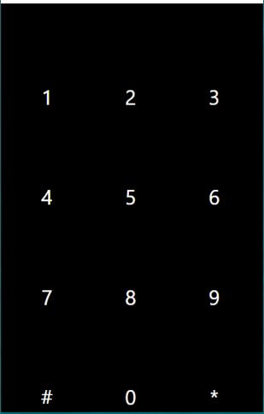
Scenario
Hello ! How may I assist you today?
What is the status of my claim?
Ok. Can you tell me your CRN?
56788
Miles, Your claim has been approved.

Slide 3



Bing Speech API
Speech Recognition
Text to Speech
Speech Intent Recognition

Slide 4
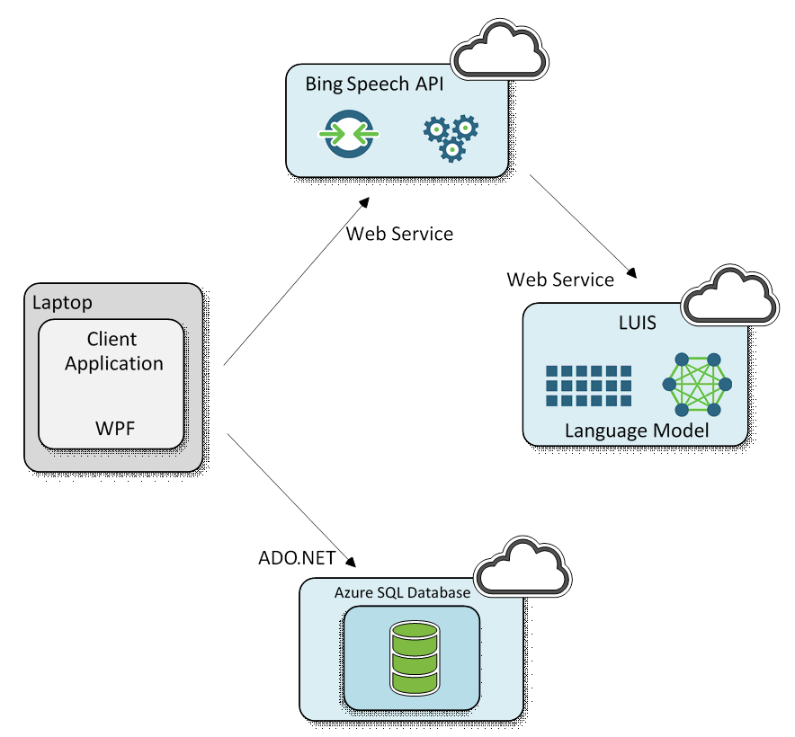
Architecture

Slide 5

Flow
Bing Speech API
Hello! How may I assist you today?
text
Text-to-Speech
What is the status of my claim?
Speech Intent Recognition
Ok. Can you tell me your CRN?
intent=“num.”
value=
“56788”
intent=“status”
entity=“claim”
56788
Miles, your claim has been approved.
query
LUIS API
Database

Slide 6
Database
DROP TABLE dbo.UserInfo
CREATE TABLE [dbo].[UserInfo](
[UserId] [varchar](50) NOT NULL,
[FirstName] [varchar](50) NULL,
[LastName] [varchar](50) NULL,
[PhoneNumber] [varchar](50) NULL,
[Entity] [varchar](50) NULL,
[EntityType] [varchar](50) NULL,
[Status] [varchar](50) NULL,
[Value] [money] NOT NULL,
[AvailableDate] [date] NOT NULL,
PRIMARY KEY (UserId)
)
GO
INSERT dbo.UserInfo VALUES
('56788','Miles','Rogerson','6170009111','Business Claim','Claim','Approved',8000.00, '2016-07-01'),
('56789','Major','Haywood','9780001111','Student Grant','Grant','In Progress',0.00, '2016-07-02'),
('56790','Winston','Easton','7819807891','Claim','Claim','Approved',10000.00,'2016-07-01'),
('56791','Mikki','Tyrrell','8045412341','Student Grant','Grant','Denied',0.00,'2016-07-05')
GO

Slide 7
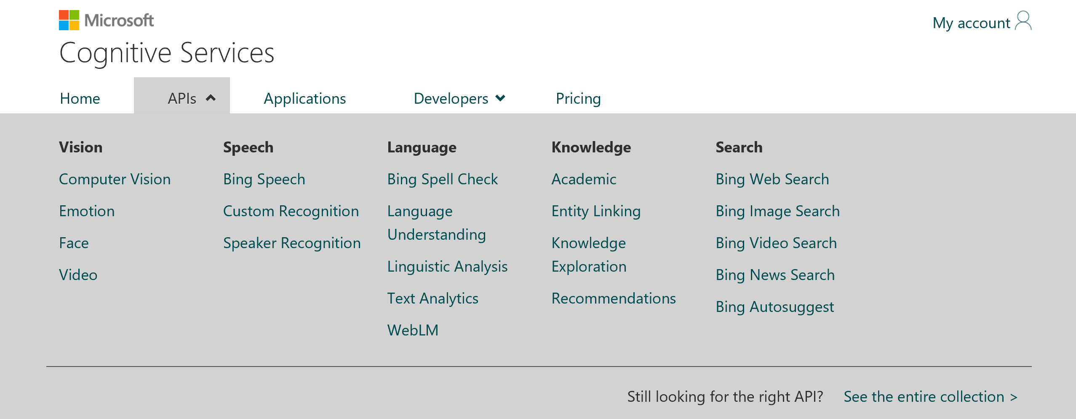


Microsoft Cognitive Services

Slide 8
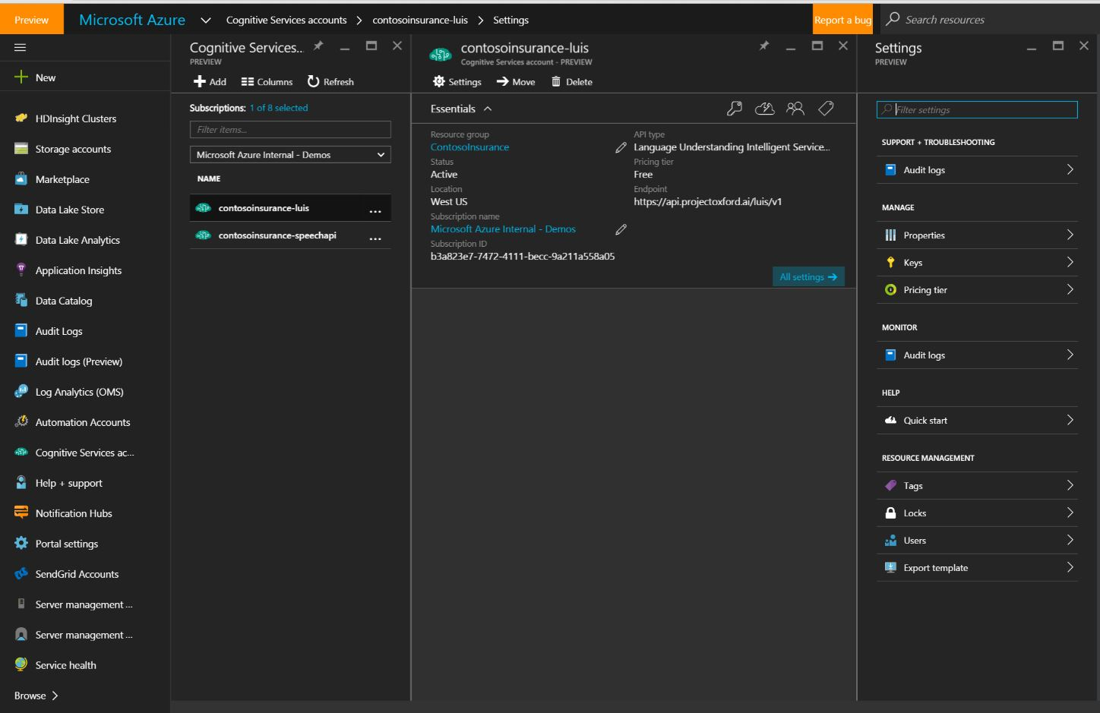
Azure Portal Cognitive Services Account

Slide 9
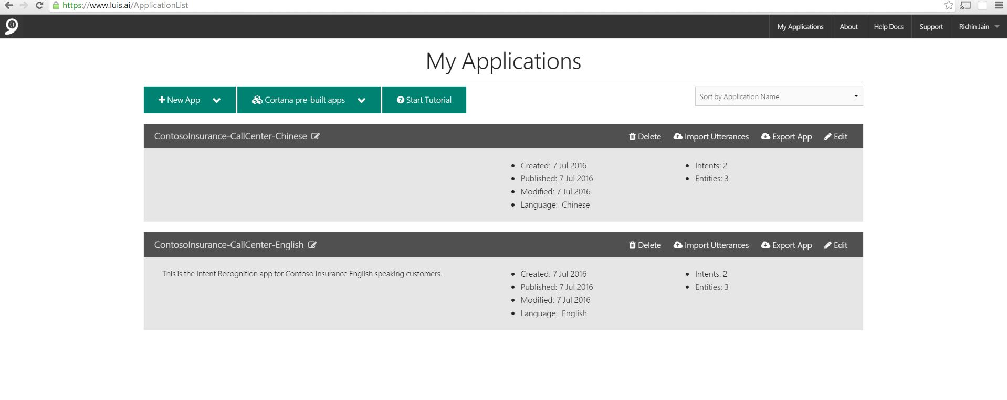
LUIS Applications Dashboard

Slide 10
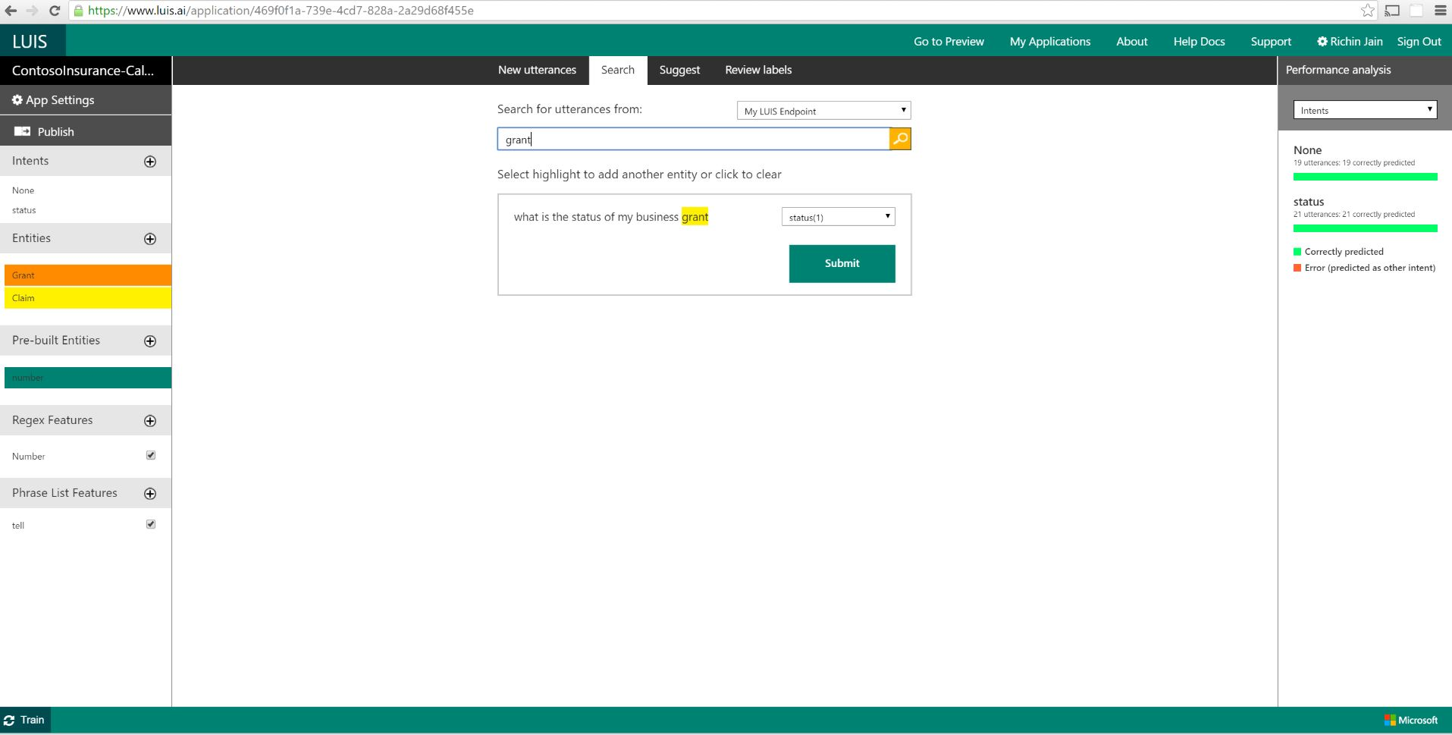
LUIS Application - English

